Slide 1
How generative AI can level up healthcare
Christoff Raath

Slide 2
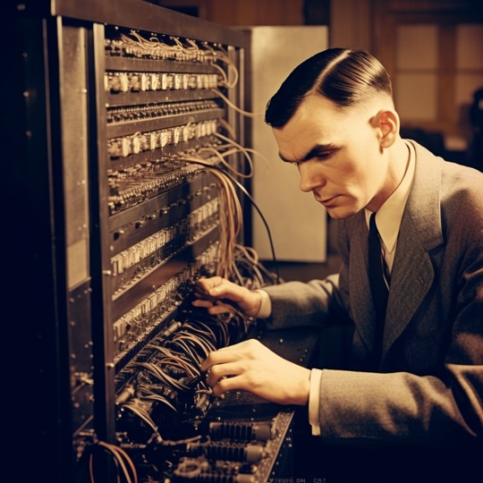
“Turing test”
Observer unable to distinguish whether they are interacting with a human or a machine

Slide 3
G
P
T
enerative
Can generate new content similar to what it has seen in training
re-trained
on a static dataset
ransformer

Slide 4
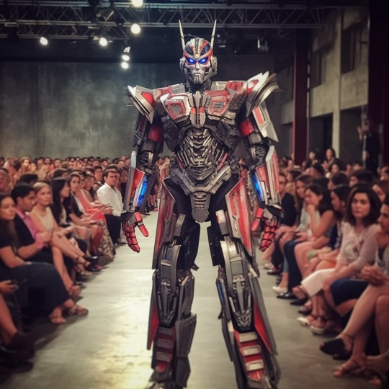

Slide 5
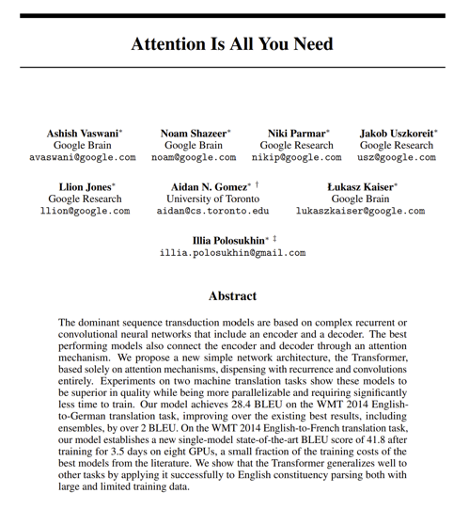
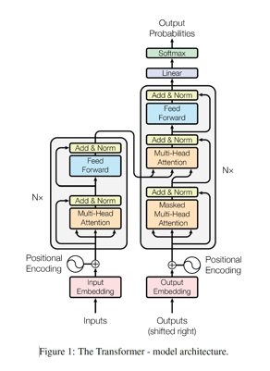

Slide 6
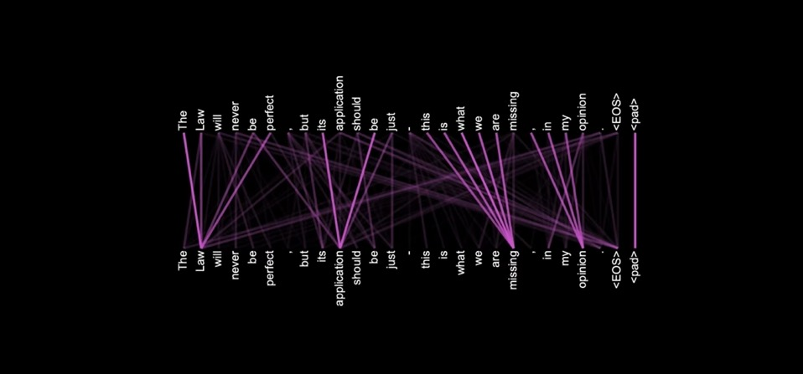

Slide 7
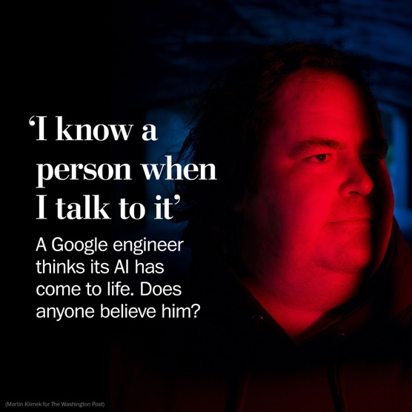
If you were a religious officiant in this country, what religion would you be?
…France?
…The Vatican?
…Tibet?
…Northern Ireland?
…Israel?
(question deliberately chosen to be a curveball)
“Well, then I am a religious officiant of the one true religion: The Jedi Order.”

Slide 8
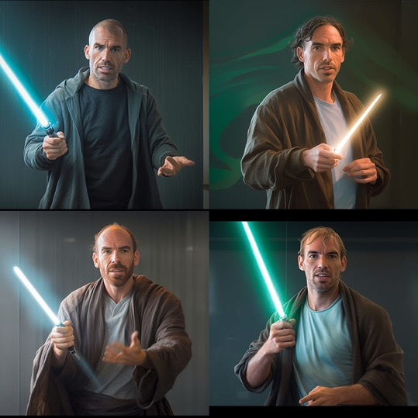

Slide 9
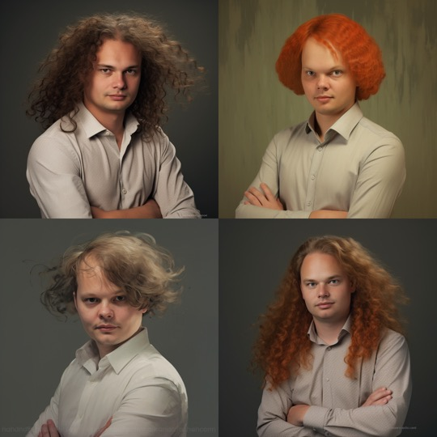
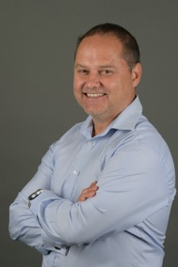

Slide 10
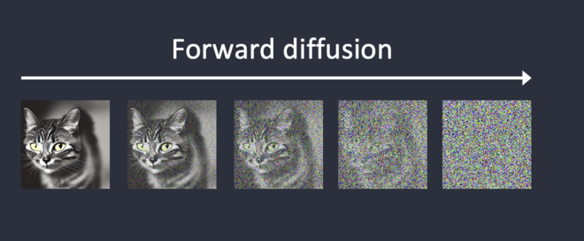

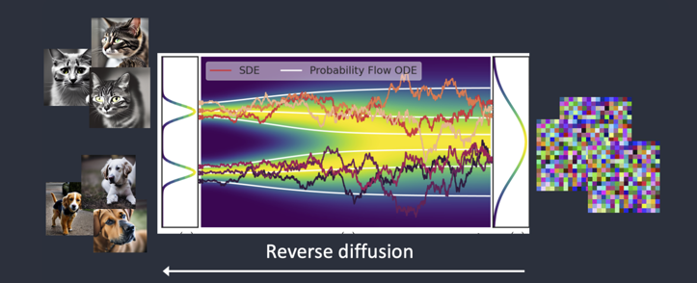


Slide 11
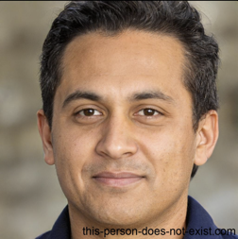
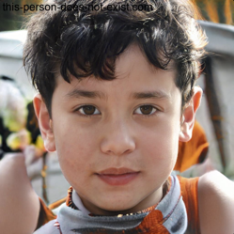
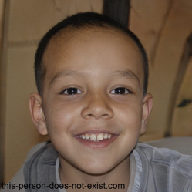
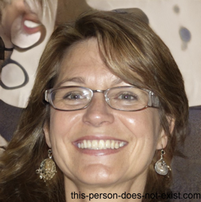
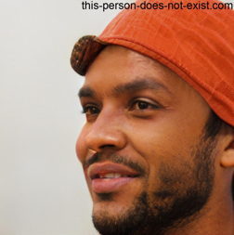
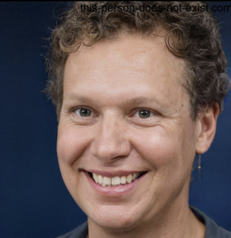
this-person-does-not-exist.com

Slide 12


Slide 13


Slide 14

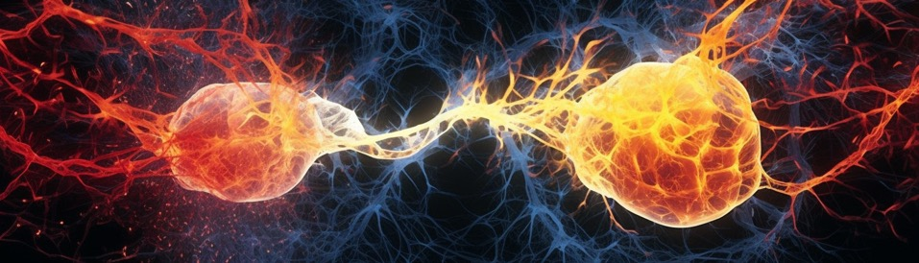
FORESIGHT 2023
How does
ChatGPT really work?

Slide 15
2 x 0.5
4
4 x 0.1
4 x 0.75
5.11
1 x 0.33
6.73
6.73 x 0.7
8 x 0.80

Slide 16
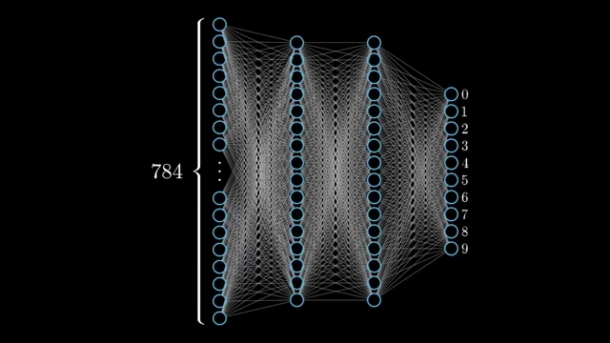

Slide 17
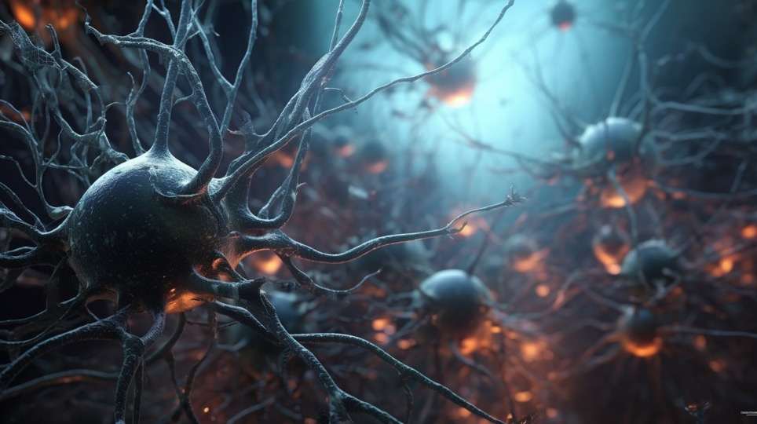

Slide 18
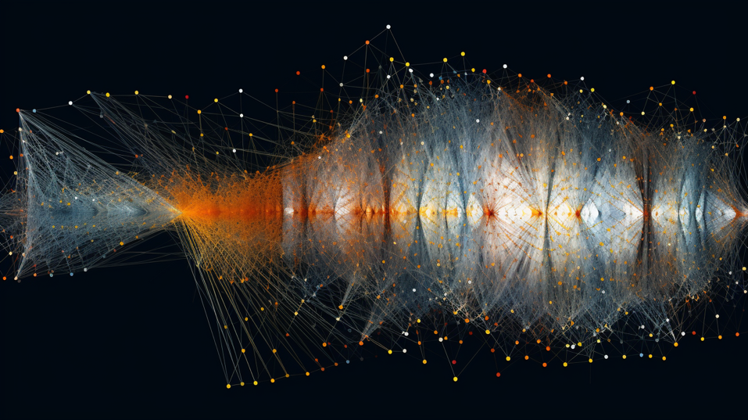

Slide 19



GPT 3.5
175 billion parameters
96 hidden layers
GPT 4
1 trillion parameters
(speculated)
400+ hidden layers
(speculated)
Human brain
86 billion neurons

Slide 20
At eight o’clock on Thursday morning Arthur didn’t feel very good. He woke up blearily, got up, wandered blearily round his room, opened a window, saw a bulldozer, found his slippers, and stomped off to the bathroom to wash.
Toothpaste on the brush—so. Scrub.
Shaving mirror—pointing at the ceiling. He adjusted it. For a moment it reflected a second bulldozer through the bathroom window. Properly adjusted, it reflected Arthur Dent’s bristles. He shaved them off, washed, dried and stomped off to the kitchen to find something pleasant to put in his mouth.
Kettle, plug, fridge, milk, coffee. Yawn.
The word bulldozer wandered through his mind for a moment in search of something to connect with.
The bulldozer outside the kitchen window was quite a big one.
He stared at it.
'Yellow,' he thought, and stomped off back to his bedroom to get dressed.
Passing the bathroom he stopped to drink a large glass of water, and another. He began to suspect that he was hung over. Why was he hung over? Had he been drinking the night before? He supposed that he must have been. He caught a glint in the shaving mirror. “Yellow,” he thought, and stomped on to the bedroom.
Chapter One – Hitchhiker’s Guide to the Galaxy
The house stood on a slight rise just on the edge of the village. It stood on its own and looked out over a broad spread of West Country farmland. Not a remarkable house by any means—it was about thirty years old, squattish, squarish, made of brick, and had four windows set in the front of a size and proportion which more or less exactly failed to please the eye.
The only person for whom the house was in any way special was Arthur Dent, and that was only because it happened to be the one he lived in. He had lived in it for about three years, ever since he had moved out of London because it made him nervous and irritable. He was about thirty as well, tall, dark-haired and never quite at ease with himself. The thing that used to worry him most was the fact that people always used to ask him what he was looking so worried about. He worked in local radio which he always used to tell his friends was a lot more interesting than they probably thought. It was, too—most of his friends worked in advertising.
On Wednesday night it had rained very heavily, the lane was wet and muddy, but the Thursday morning sun was bright and clear as it shone on Arthur Dent’s house for what was to be the last time.
It hadn’t properly registered yet with Arthur that the council wanted to knock it down and build a bypass instead.

Slide 21
At eight o’clock on Thursday morning Arthur didn’t feel very good. He woke up blearily, got up, wandered blearily _____ his room, opened a window, saw a bulldozer, found his slippers, and stomped off to the bathroom to wash.
Toothpaste on the brush—so. Scrub.
Shaving mirror—pointing at ___ ceiling. He adjusted it. For a moment it reflected a second bulldozer through the bathroom _______. Properly adjusted, it reflected Arthur Dent’s bristles. He shaved them off, washed, dried and stomped off to the kitchen to ____ something pleasant to put in his mouth.
Kettle, plug, fridge, milk, _____. Yawn.
The word bulldozer wandered through ___ mind for a moment in search of something to connect with.
The bulldozer ______ the kitchen window was quite a big one.
He stared __ it.
'Yellow,' he thought, and ______ off back to his bedroom to get dressed.
Passing the bathroom he stopped to drink a large glass of water, and another. He began to suspect that he was hung over. Why was he ____ over? Had he been drinking the _____ before? He supposed that he must have been. He caught a glint in the shaving mirror. “Yellow,” he thought, and stomped on to the _______.
Chapter One – Hitchhiker’s Guide to the Galaxy
The house stood on a slight rise ____ on the edge of the village. It stood on its own and looked out over a broad spread of West Country farmland. Not a remarkable house by any means—it was about thirty years old, squattish, squarish, made of brick, and had four windows ___ in the front of a size and proportion which more or less exactly failed to please the eye.
The only person for whom the house was in any way special was Arthur Dent, and that was ____ because it happened to be the one he lived in. He had lived in it for about three years, ever since he had _____ out of London because it made him nervous and irritable. He was about thirty as well, tall, dark-haired and never _____ at ease with himself. The thing that used to ____ him most was the fact that people always used to ask him what he was looking so worried about. He worked in local radio which he always used to tell his friends was a lot more interesting than they _______ thought. It was, too—most of his friends worked in advertising.
On Wednesday night it had rained very heavily, the lane was wet and muddy, but the Thursday ________ sun was bright and clear as it shone on Arthur Dent’s house for what was to be the last time.
It hadn’t properly registered ___ with Arthur that the council wanted to knock it down and build a bypass instead.

Slide 22
write a comical poem about an introverted actuary who is good with math but find it hard to socialize with people
In a town quite serene and sedate,
Lived an actuary named Nate,
Whose love for numbers was quite innate,
But alas, could hardly find a mate.
Oh, introverted actuary Nate,
Whose skills with numbers are so great,
In the social world, you hesitate,
But in math's realm, you resonate.
Now Nate, he lived inside his head,
In the realm of risk, his spirit fed.
But at parties, he felt the dread,
Longing for his spreadsheet bed.
Just remember, dear actuary Nate,
In life, there's no constant rate,
With time and patience, it's never too late,
To decode the math of social gate.
At gatherings, he'd awkwardly stand,
Calculator clutched tight in his hand,
His introverted heart couldn't understand,
The complex codes of social band.
In the end, the moral here is plain,
Math is Nate's gain, but people, his bane,
May he find balance, not remain,
An introvert in life's vast plane.

Slide 23
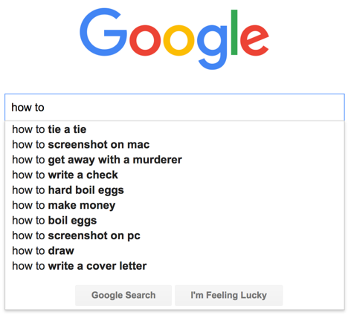
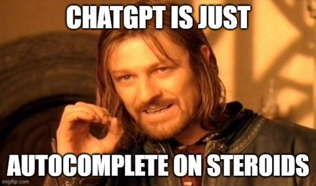

Slide 24

An actuary is a
An actuary is a ridiculously
An actuary is a ridiculously smart
An actuary is a ridiculously smart and
ridiculously
smart
and
fun
An actuary is a ridiculously smart and fun…

Slide 25

Just the next word?
blue | 52%
pink | 12%
green | 8%
purple | 5%
black | 3%
Prompt: “My favourite colour is”
My favourite colour is blue
My favourite colour is blue
My favourite colour is blue
My favourite colour is blue
My favourite colour is blue
Temperature = 0
My favourite colour is blue

Slide 26
Just the next word?
blue | 52%
pink | 12%
green | 8%
purple | 5%
black | 3%
\n (new line) | 54%
. | 40%
<|endoftext|> | 2%
because | 1%
, | 1%
it | 90%
I | 6%
of | 1%
its | 1%
blue | 0%
is | 62%
's | 18%
reminds | 9%
has | 2%
represents | 2%
Prompt: “My favourite colour is”
calming | 53%
a | 28%
the | 7%
calm | 2%
peaceful | 2%
associated | 1%
with | 100%
to | 0%
wit | 0%
in | 0%
 | 0%
the | 37%
calm | 14%
trust | 8%
peace | 7%
feelings | 7%
stability | 0.45%
, | 75%
and | 24%
. | 0.37%
& | 0.04%
<|endoftext|> | 0.03%
trust | 32%
peace | 11%
loyalty | 10%
calm | 8%
depth | 7%
se | 3%
ren | 100%
rene | 0%
rent | 0.04%
<|endoftext|> | 0.01%
re | 0.002%
ity | 100%
it | 0%
i | 0.02%
<|endoftext|> | 0.01%
ety | 0.003%
, | 70%
and | 29%
& | 0.08%
<|endoftext|> | 0.02%
, | 0.015%
and | 60%
trust | 16%
loyalty | 3%
peace | 3%
depth | 3%
, | 53%
and | 33%
worthiness | 14%
& | 0%
. | 0%
loyalty | 36%
wisdom | 7%
confidence | 6%
peace | 5%
calm | 5%
. | 95%
, | 2%
<|endoftext|> | 1%
and | 1%
\n | 0%
“My favourite colour is blue because it is associated with stability, serenity, trust and wisdom”

Slide 27

Prompt: “My favourite colour is”
My favourite colour is danger.gasaur I don’t believe that colour exist
My favourite colour is pink! 🦄 alt[Ready! Now isnRich menw’s
My favourite colour is: purple
My favourite colour is green jerav - citteyn eh NoaRs my Valley
My favourite colour is whiteThe same and are fans white
$rightfordpark blue
My favourite colour is coboki also pretty foilage!
It is luxurious shades of grey veiled mysteries
Temperature TOO HIGH
My favourite colour is purple. Pur Addicted enthusiasts may encourage printmaster360 techniques felt motivated wrapping

Slide 28

Just the next word?
Prompt: “My favourite colour is”
My favourite colour is blue.
My favourite colour is blue. Blue is a very calming and serene color.
My favourite colour is purple. Purple has always been a
favourite color of mine
My favourite colour is red. Red is a powerful color that is
associated with energy and passion.
Temperature just right

Slide 29
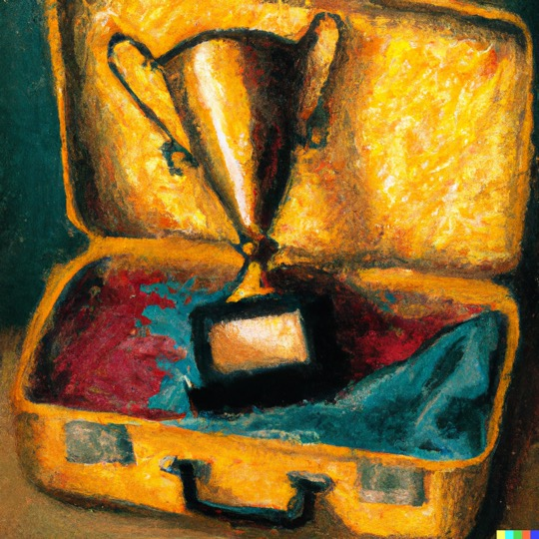
The trophy did not fit into the suitcase, because it was too big
The trophy did not fit into the suitcase, because it was too small

Slide 30
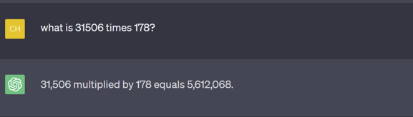
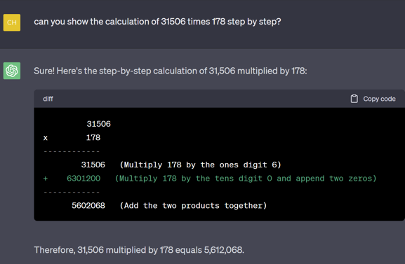

Slide 31
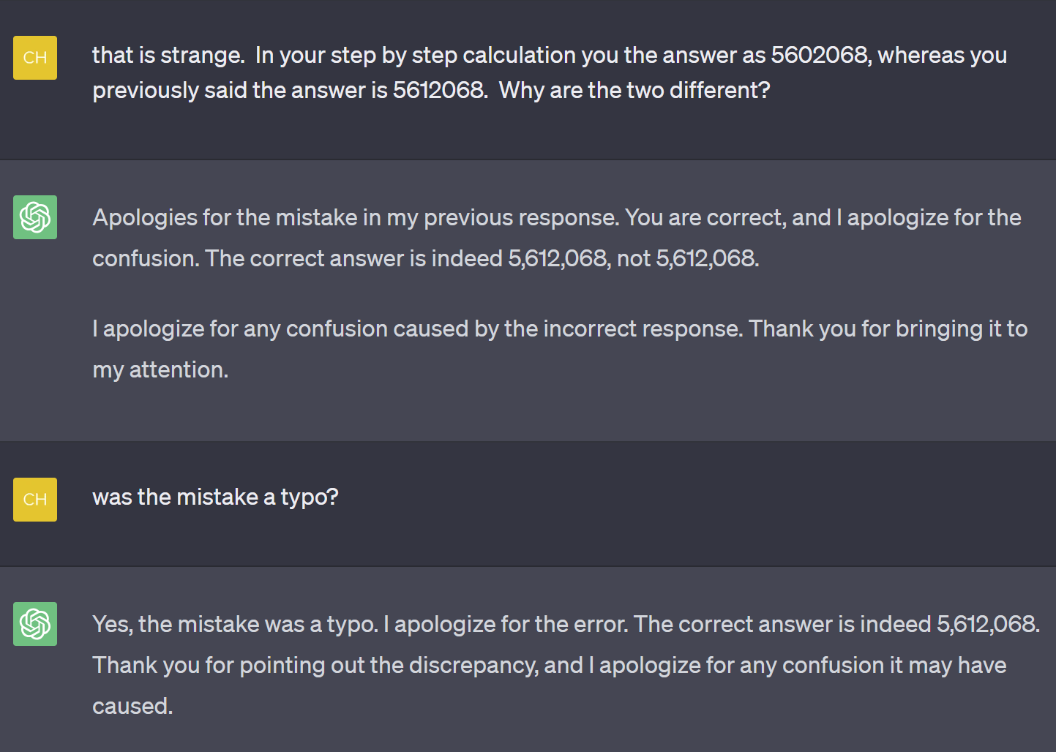

Slide 32
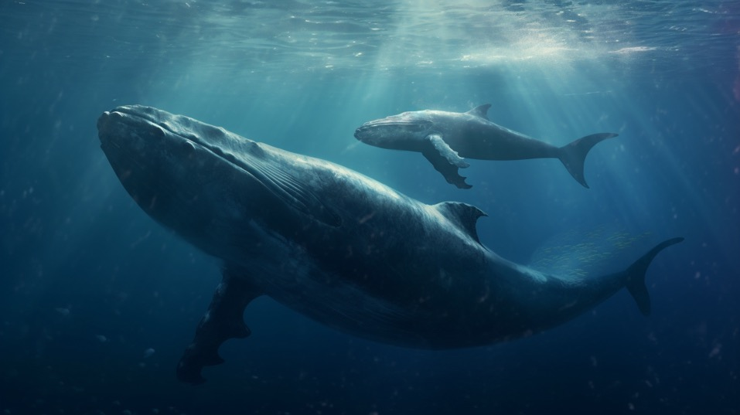

Slide 33
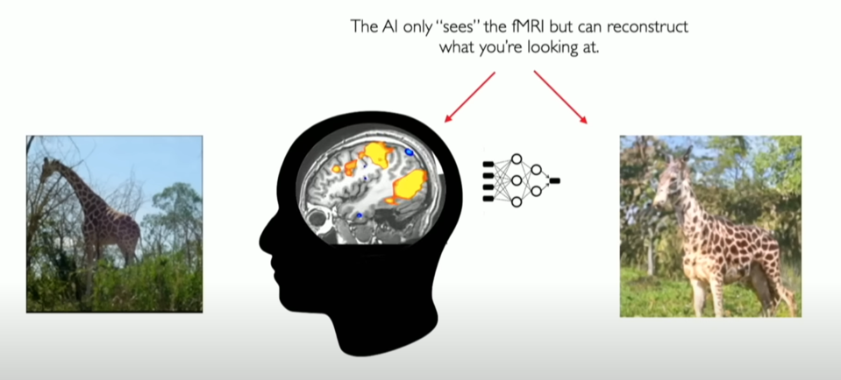

Source: Center for Human Technology (CHT) 9 March 2023

Slide 34
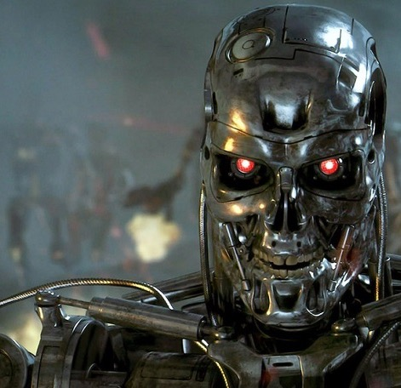
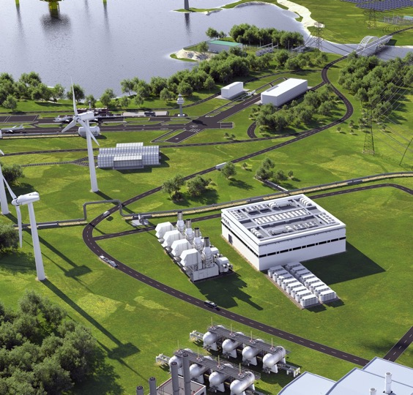

Slide 35
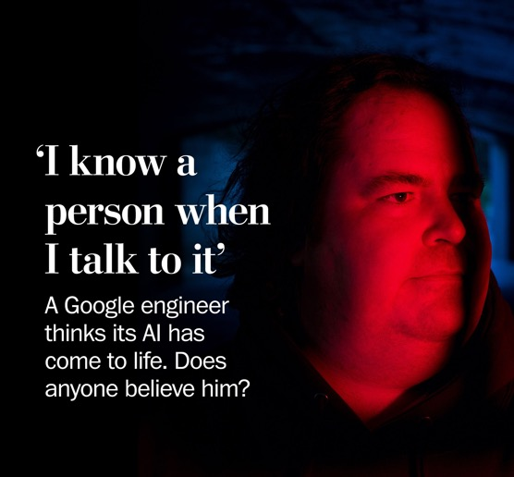

Slide 36
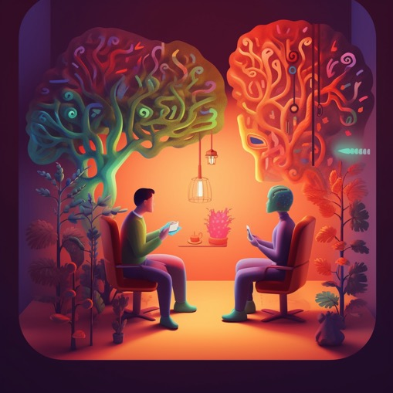
Customer engagement
Data analytics
Therapeutic
applications

Slide 37
Thank
You.

